Slide 1


A Comparative Study on EEG-based Models for Automatic Discrimination of Mental Attentional Levels during Simulated Flying Tasks
Chaoyi Hu, Tianyi Hu, Xingyue Wang, Zejun Yan

Slide 2
Contents
Background
Objectives and design
Significance
Methods
Results
Conclusion
Discussion

Slide 3
Contents
Background
Objectives and design
Significance
Methods
Results
Conclusion
Discussion

Slide 4
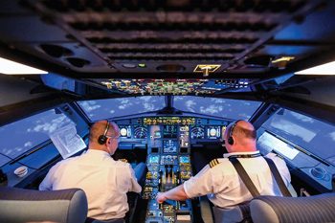
Background
Monitoring attentional level of pilots can reduce the number of accidents caused by low attentional level during flying

Slide 5
Background
Study | Application background | EEG channels | preprocessing | Feature extracted | classifier | Offline/Online | fps | acc
Huan Wu, 2020 | - | 4 | Wavelet transform | β/θ, SE | / | Offline | NA | /
Wei,2018 | Driving alertness/fatigue | 4* | Bandpass filtering, artifact elimination | Features of α, β, θ band | LDA, kNN, SVM | Offline | NA | 0.781,0.773,0.8
Hu,2018 | Driving alertness/fatigue | 30* | Bandpass filtering | SE | GBDT | Offline | NA | 0.94
HaiYu Wang,2018 | Driving alertness/fatigue | 30* | Wavelet transform | Principle components of α/β/θ/δ band features | LS-SVM | Offline | NA | 0.8947
Koji,2017 | Identification of road signs | 1 | Baseline correction, threshold rejection (±80μV) | Features of θ band | DCNN | Offline | NA | /
Monammad, 2018 | Driving alertness/fatigue | 4* | None (Raw data) | / | deep CNN | Offline | NA | 0.9531
Wang, 2018 | Driving alertness/fatigue | 24 | Detrending, baseline correction, bandpass filtering | PSD SE | / | Online | 0.1fps(10s sequence) 0.5fps(2s sequence) | /
Costa, 2019 | Attentional level during rehabilitation training | 31* | Bandpass filtering, standardization, Maximum entropy spectrum estimation | Features of γ band | LDA | Online | 1fps(1s sequence) | 0.681
Note: ‘*’ represents 32-channel EEG

Slide 6
Background
Remaining problems
Low accuracy in online (real-time) classification
Low versatility when models are applied to multiple subjects
Few comparative studies on the performances of different attentional level detection models

Slide 7
Contents
Background
Objectives and design
Significance
Methods
Results
Conclusion
Discussion

Slide 8
Objectives and design
Objective
Discriminate different attentional levels (L/M/H) during simulated flying tasks (0.5 fps: 2s sequence for classification)
Compare the performances of 1) classic classifiers and 2) deep learning models in terms of their accuracy and versatility

Slide 9
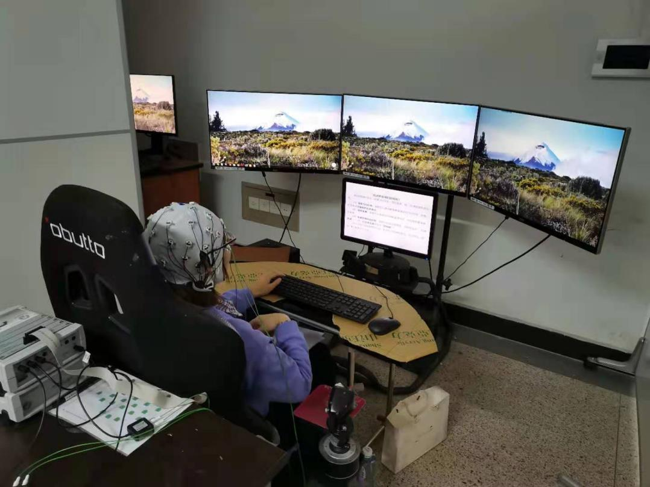
Objectives and design
Data collection
Attentional level | Task difficulty | Main task
L | L | Watch recorded flying tasks
M | M | Perform simulated flying tasks
H | H | Perform simulated flying tasks with constraints

Slide 10
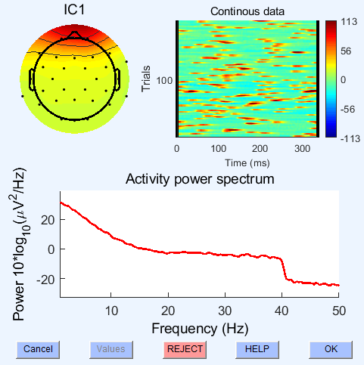
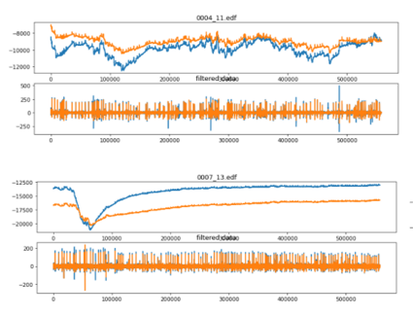
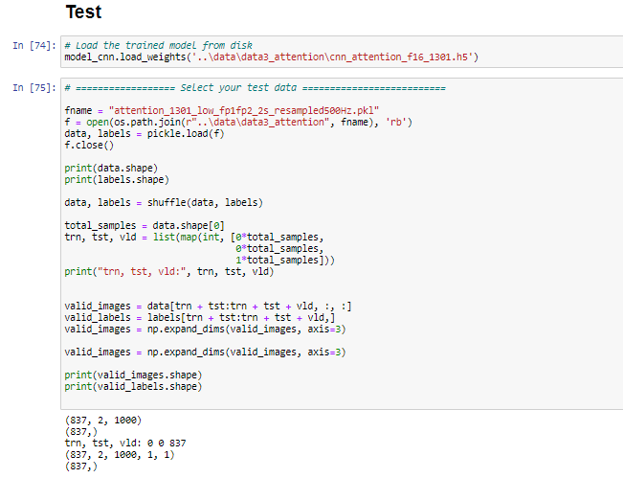
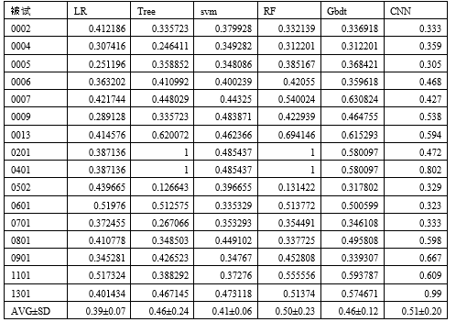
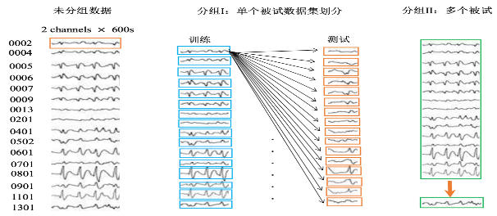
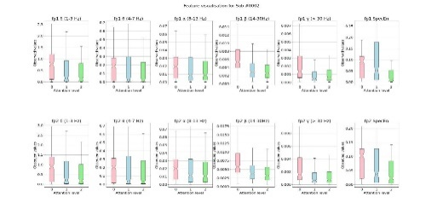
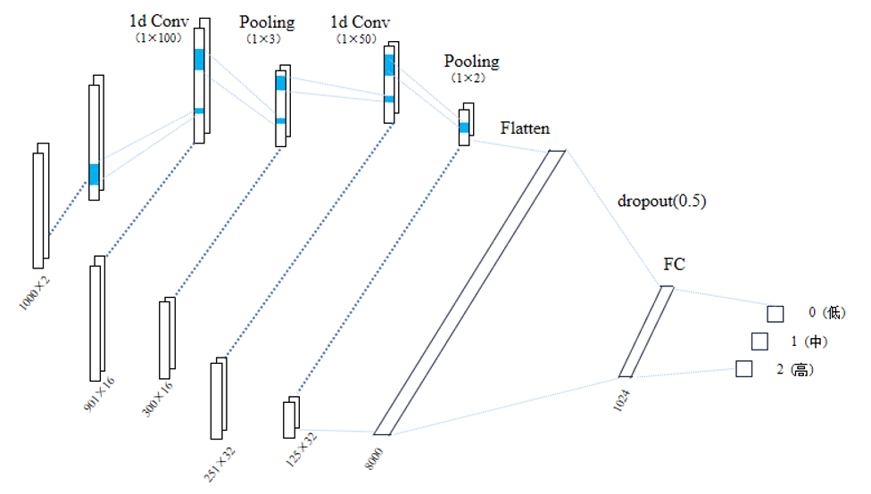
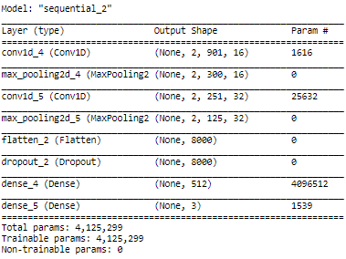
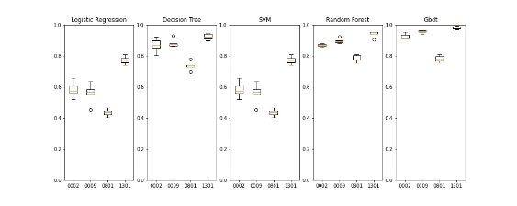
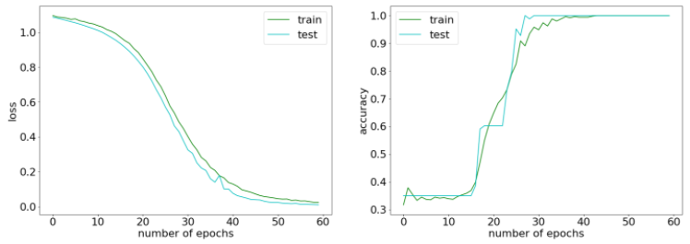
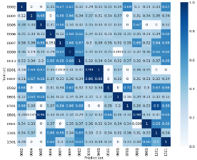
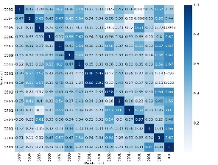
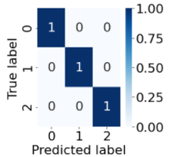
Objectives and design
Data preprocessing and quality control
On one single subject
Exploratory analysis, visualization, building and testing models on a baseline dataset
On multiple subjects

Slide 11
Contents
Background
Objectives and design
Significance
Methods
Results
Conclusion
Discussion

Slide 12
Significance
From an application perspective,
Help avoid accidents caused by decreased attention level during long-term tasks
From a research perspective,
By comparing the performances of different models, this study will provide information to help select and optimize real-time attentional level detection methods.

Slide 13
Contents
Background
Objectives and design
Significance
Methods
Results
Conclusion
Discussion

Slide 14
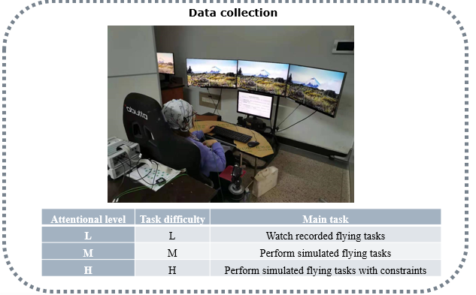
Methods
Difficulty of task
Attentional level
Classification output
H
H
H
M
M
M
L
L
L
？
Comparing performances
Assumption:
L/M/H difficulty ->
L/M/H attentional level

Slide 15
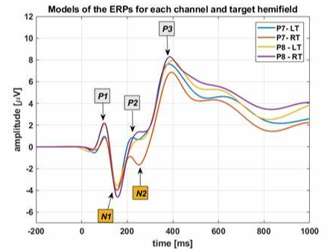
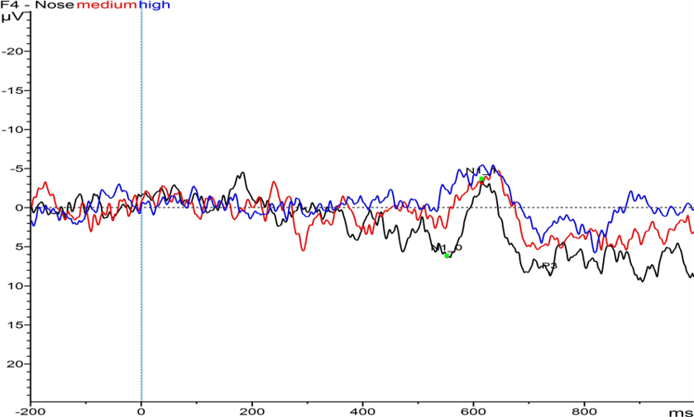
Methods
Secondary task (auditory stimulus)
While performing the main task at L->M->H difficulty:
Smaller changes in amplitude of N1 and P3 caused by auditory stimulus
Less attentional resource for secondary task
Higher attentional level for the main task
(a)
(c)
(b)
N1 | F4 | F7 | F8
L | -9.83487 | -9.07869 | -11.6394
M | -7.94818 | -6.68929 | -9.08544
H | -5.98145 | -5.6432 | -7.30027
P3 | Fz | F7 | F3 | FC1 | FC2
L | 11.17331 | 12.05532 | 10.08901 | 11.85864 | 12.46203
M | 10.55667 | 8.036693 | 8.90429 | 10.75337 | 11.39706
H | 8.866953 | 4.57331 | 6.886431 | 9.285172 | 10.12889
Notes:
如图所展示的，蓝红黑分别代表任务高中低，可以清楚看到随着主任务难度的增加，第二任务，也就是声音刺激下引起的事件相关电位N1和P3波动幅度下降，这就意味着第二任务所调用的注意资源减少，也就意味着主任务，即飞行驾驶任务所占用的注意资源增加。

Slide 16
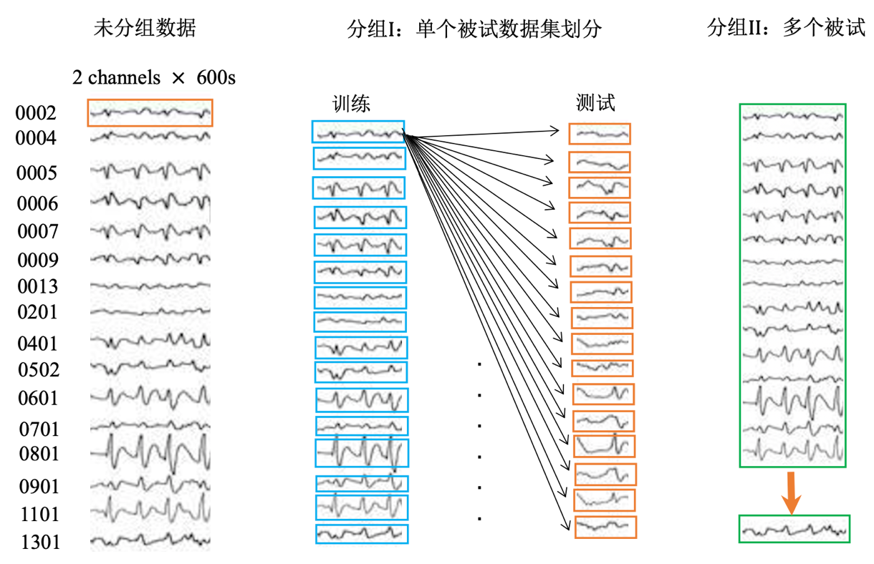
Methods
Data not grouped (16 subjects)
Grouping 1 (single subject test):
Train on subject A + Test on subject A

Slide 17
Methods
Data not grouped (16 subjects)
Grouping 2 (single subject cross test):
Train on subject A + Test on subject B

Slide 18
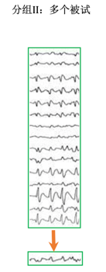
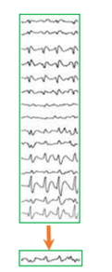
Methods
Data not grouped (16 subjects)
Grouping 3 (multiple subjects cross test):
Train on 15 subjects other than A + Test on subject A
……

Slide 19
Methods
Experiment setup
EEGLAB 14_1_2b
Python 3.8.3 (conda 4.9.2，jupyter 1.0.0，notebook 6.1.5，keras 2.4.3，numpy 1.19.4，pandas 1.1.5，scikit-learn 0.23.2，scipy 1.5.3，tensorflow 2.3.0，mne 0.22.0，matplotlib 3.3.3，seaborn 0.11.0)
1×Intel(R) Core i7-8550U CPU，1×Intel(TM) Core i5-4300U CPU。

Slide 20
Contents
Background
Objectives and design
Significance
Methods
Results
Discussion
Conclusion
Testing on a baseline dataset with the expected input dimensions for rationality check
Pre-experiment
Preparing baseline dataset
Testing classic classification models
Testing and tuning DL models
Experiment
Data preparation
Model effectiveness: single subject test
Model versatility: single subject / multiple subjects cross test

Slide 21
Pre-experiment
Baseline dataset
Strictly controlled data quality
Relatively consistent data distribution
Less randomness
Separable (for classification, with learnable features)

Slide 22
Pre-experiment
Preparing baseline dataset: manual pre-processing
EEG data of subject 0002, 0009, 0801, 1301
Import .edf file
Electrode placement: 10-5 system
Remove VEOG、HEOG、ECG
Re-reference on Fc6
Resample to 500Hz
Bandpass filtering 0.1-40Hz
Baseline correction, interpolating, rejecting bad segments
ICA
Take Fp1，Fp2 channels, divide into 2s sequences (2 channels×1000 sample points)

Slide 23
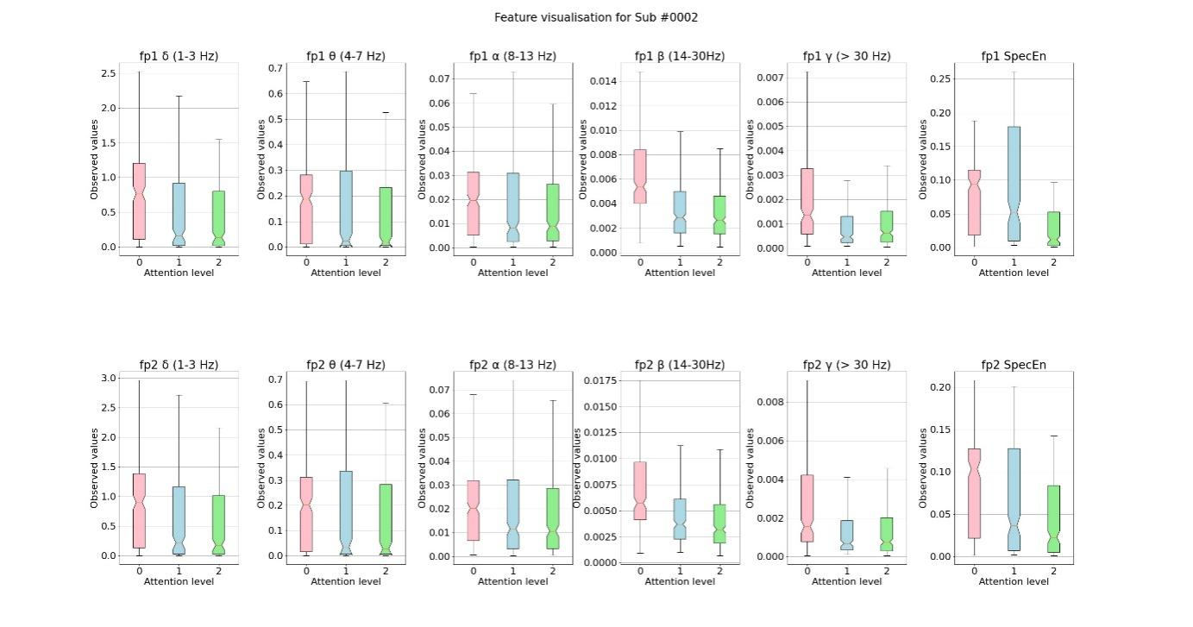
Pre-experiment
Preparing baseline dataset: visualizing separable features
Visualizing Fp1 & Fp2 power values of traditional frequency bands and sample entropy

Slide 24
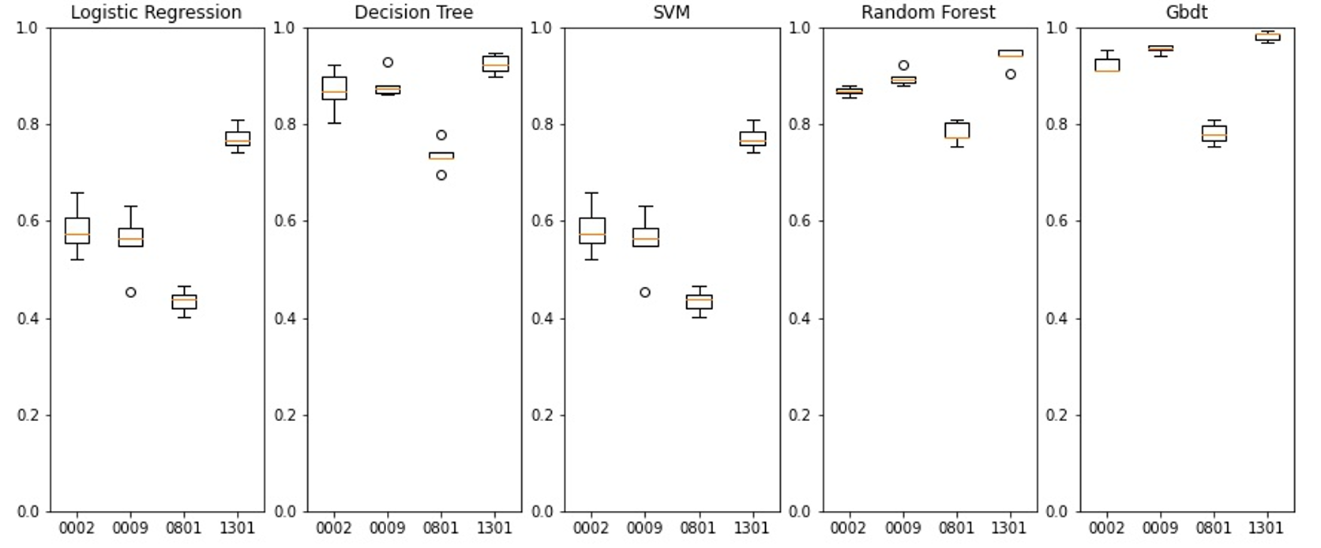
Pre-experiment
Comparing performances of different types of classic classifiers
Boxplot showing results of 5-fold validation on baseline dataset

Slide 25
Pre-experiment
Tuning CNN network
CNN structure + test result on baseline data (Single subject)

Slide 26
Comparative study
Pre-experiment: manual preprocessing
Not applicable in real-time processing due to time limitations (the frame rate)
Experiment: automatic data preprocessing

Slide 27
Comparative study
Automatic data preprocessing and quality control
Bandpass filtering: 1-30Hz
Threshold rejection: ±60μV
Normalization

Slide 28
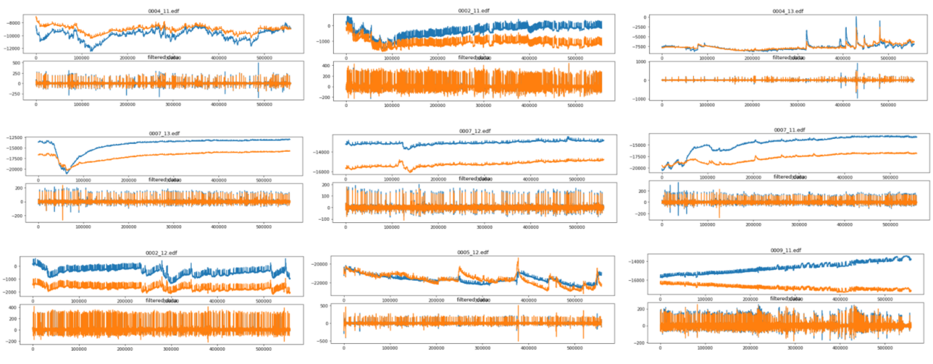
Comparative study
Automatic data preprocessing and quality control
Before and after 1~30Hz bandpass filtering

Slide 29
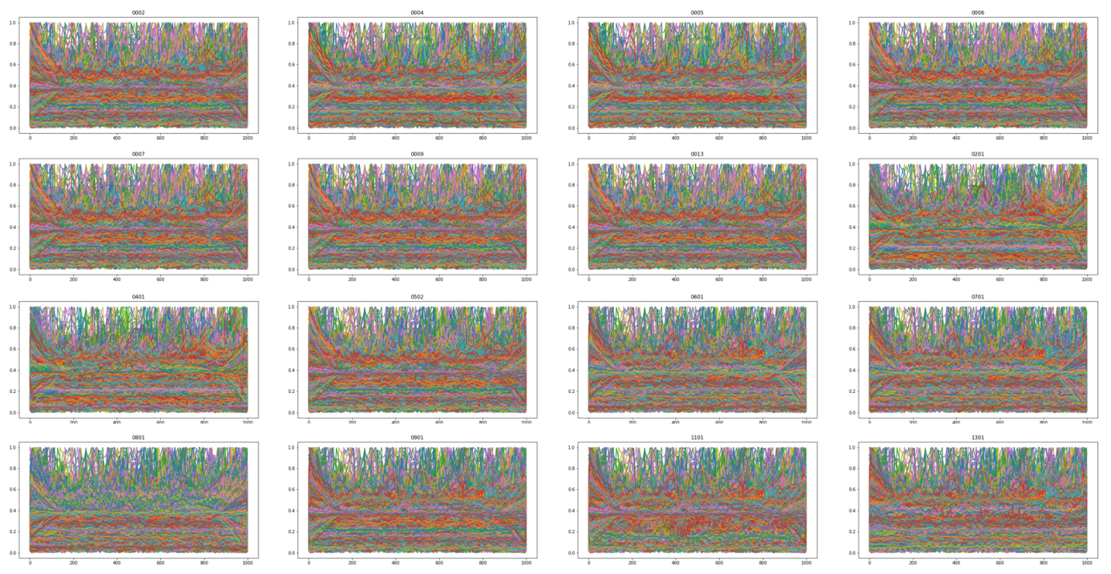
Comparative study
Automatic data preprocessing and quality control
Visualization to check data distribution (normalized to [0,1])

Slide 30
Comparative study
One data sample (2 channels, 1000 sample points) processed on Intel(R) Core i7-8550U CPU:
Start: 2021-01-08 01:49:08.425495
End: 2021-01-08 01:49:08.430481
Delta: 0.004986 s
Time consumed: less than 0.005s
Confirmed: available for real-time processing (0.5fps, input data: 2s short sequence)

Slide 31
Comparative study
subject | CNN | Logistic regression | Decision tree | SVM | Random forest | Gbdt
0002 | 1 | 0.5830411 | 0.8685344 | 0.5556031 | 0.8685771 | 0.9235386
0004 | 1 | 0.5538708 | 0.8444896 | 0.4569433 | 0.8301397 | 0.8971129
0005 | 1 | 0.4987881 | 0.9019461 | 0.4748788 | 0.9234602 | 0.9605147
0006 | 0.996 | 0.4552466 | 0.7395281 | 0.4838751 | 0.8147491 | 0.8446108
0007 | 1 | 0.466018 | 0.9163388 | 0.6893713 | 0.9247861 | 0.9642144
0009 | 1 | 0.5566724 | 0.8817508 | 0.6893499 | 0.8960721 | 0.9558169
0013 | 1 | 0.5604648 | 0.8458939 | 0.5879313 | 0.8972412 | 0.9283291
0201 | 0.96 | 0.415085 | 0.4854028 | 0.3859719 | 0.4721212 | 0.5534516
0401 | 0.927 | 0.4016556 | 0.4830007 | 0.3895196 | 0.4951515 | 0.554575
0502 | 0.996 | 0.4408397 | 0.6798332 | 0.5722341 | 0.6964927 | 0.7192686
0601 | 1 | 0.4335329 | 0.9041916 | 0.5832335 | 0.9365269 | 0.9748503
0701 | 1 | 0.4538922 | 0.8862275 | 0.4502994 | 0.8802395 | 0.948503
0801 | 0.984 | 0.4347305 | 0.7353293 | 0.4323353 | 0.7820359 | 0.7808383
0901 | 1 | 0.6893285 | 0.8673653 | 0.9617693 | 0.8877174 | 0.924722
1101 | 1 | 0.5268249 | 0.9486313 | 0.9163673 | 0.9605147 | 0.9856573
1301 | 1 | 0.7717779 | 0.9235672 | 0.8434702 | 0.9378529 | 0.9832549
AVG ±SD | 0.991 ±0.020 | 0.515 ±0.103 | 0.807 ±0.146 | 0.592 ±0.182 | 0.825 ±0.149 | 0.869 ±0.143
Effectiveness of the model: Single subject test
For each model: 1×16
Classic classifiers: Gbdt 86%
Deep learning: CNN 99%
ANOVA (CNN vs Gbdt): p value = 4.9×10e-7
SD (n=16) shows that CNN has the most stable performance in single subject test
Compared with the classic classification model, CNN shows high accuracy and high stability in single subject test
Notes:
因此，在单个被试的预测任务中，CNN相较于频谱特征提取模型准确率显著较高

Slide 32
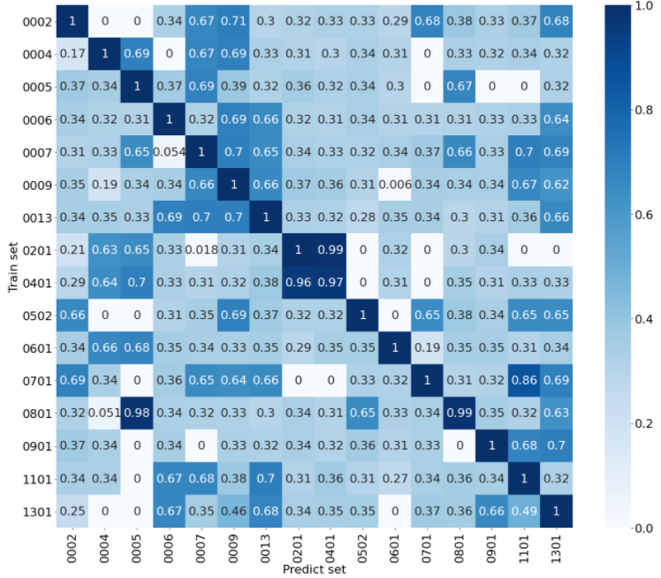
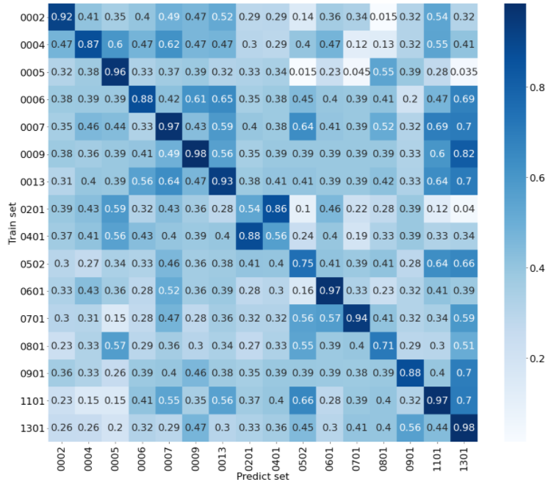
Comparative study
Versatility of the model: Single subject cross test
CNN
Gbdt
16 subjects, 256 tests performed.
Diagonal values: CNN near 1, Gbdt 0.75~1, confirming results in the single subject test.
Notes:
因此，在单个被试的预测任务中，CNN相较于频谱特征提取模型准确率显著较高

Slide 33
Comparative study
Control: random triple classification. Theoretical accuracy 33.33% assuming that data is evenly distributed.
Reshape 16×16 matrices into 256×1 vectors, remove diagonal values. Average accuracy: CNN：0.373, Gbdt：0.389, both slightly higher than control
ANOVA (CNN vs Gbdt): p value = 0.1543
Randomness caused by individual differences affects the classification results considerably. Attention classification based on EEG should first consider using the data of the same individual for model training to ensure that the fitted model is applicable for the exact individual.
Models trained on data of subject A should not be directly applied to the attentional level detection of subject B.

Slide 34
Comparative study
Apart from the diagonal values:
More than half of the value is around 33%
Approximately 1/4 of the values are around 67%
Some values are very close to 0
In merely 4 tests does the value reached above 80%
Discussion: why do special values such as 0，33%，66% occur repeatedly

Slide 35
Comparative study
subject | CNN | Logistic regression | Decision tree | SVM | Random forest | Gbdt
0002 | 0.333 | 0.412186 | 0.335723 | 0.379928 | 0.332139 | 0.336918
0004 | 0.359 | 0.307416 | 0.246411 | 0.349282 | 0.312201 | 0.312201
0005 | 0.305 | 0.251196 | 0.358852 | 0.348086 | 0.385167 | 0.368421
0006 | 0.468 | 0.363202 | 0.410992 | 0.400239 | 0.42055 | 0.359618
0007 | 0.427 | 0.421744 | 0.448029 | 0.44325 | 0.540024 | 0.630824
0009 | 0.538 | 0.289128 | 0.335723 | 0.483871 | 0.422939 | 0.464755
0013 | 0.594 | 0.414576 | 0.620072 | 0.462366 | 0.694146 | 0.615293
0201 | 0.472 | 0.387136 | 1 | 0.485437 | 1 | 0.580097
0401 | 0.802 | 0.387136 | 1 | 0.485437 | 1 | 0.580097
0502 | 0.329 | 0.439665 | 0.126643 | 0.396655 | 0.131422 | 0.317802
0601 | 0.323 | 0.51976 | 0.512575 | 0.335329 | 0.513772 | 0.500599
0701 | 0.333 | 0.372455 | 0.267066 | 0.353293 | 0.354491 | 0.346108
0801 | 0.598 | 0.410778 | 0.348503 | 0.449102 | 0.337725 | 0.495808
0901 | 0.667 | 0.345281 | 0.426523 | 0.34767 | 0.452808 | 0.339307
1101 | 0.609 | 0.517324 | 0.388292 | 0.37276 | 0.555556 | 0.593787
1301 | 0.99 | 0.401434 | 0.467145 | 0.473118 | 0.51374 | 0.574671
AVG ±SD | 0.51 ±0.20 | 0.39 ±0.07 | 0.46 ±0.24 | 0.41 ±0.06 | 0.50 ±0.23 | 0.46 ±0.12
Versatility of the model: 16-fold cross test (15 for 1)
ANOVA (CNN vs Gbdt): p value = 0.2896
Compared with the accuracy of single subject cross test (CNN: 0.373, Gbdt: 0.389), expanding and diversifying the training dataset gives better results (CNN: 0.51, Gbdt: 0.46). This improvement in the versatility of the models probably resulted from a decrease in randomness.
Notes:
因此，在单个被试的预测任务中，CNN相较于频谱特征提取模型准确率显著较高

Slide 36
Contents
Background
Objectives and design
Significance
Methods
Results
Conclusion
Discussion

Slide 37
Conclusion
Effectiveness of the model: single subject test (A->A)
Both the classic classification models and deep learning models are sufficient to use in classifying single-session data, CNN performs significantly better than ML models based on spectral/non-linear features.
Versatility of the model: single subject cross test (A->B)
Low accuracy in all models constructed, indicating that individual differences exert significant effect on the versatility of models.
Versatility of the model: multiple subjects cross test (others -> A)
Training on data of multiple subjects may reduce the randomness between individuals and improve versatility of the models.

Slide 38
Contents
Background
Objectives and design
Significance
Methods
Results
Conclusion
Discussion

Slide 39
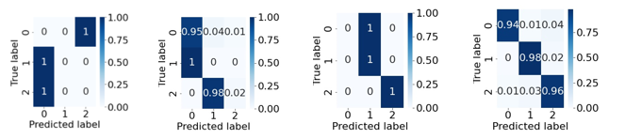
Error Analysis
Possible sources of error
Noise in the dataset
Randomness caused by individual differences
Data distribution
Confusion matrix for single subject cross test, left to right: near 0, 33% (1/3), 67% (2/3), 1

Slide 40
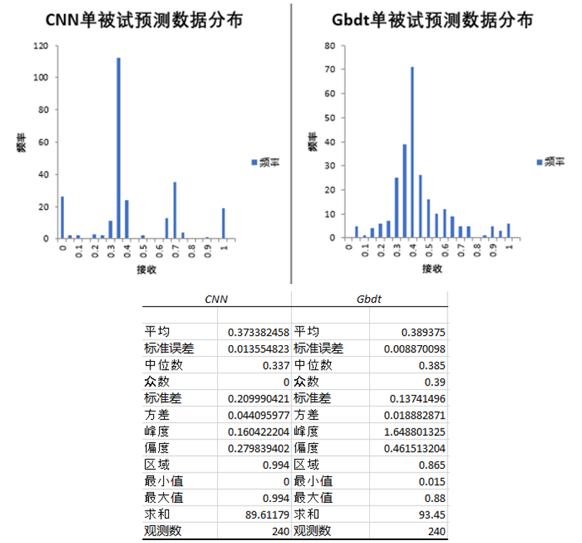
Error Analysis
Visual inspection of data distribution: given the similar average values, the accuracies of CNN model fall more frequently in range [0.3,0.4] and [0.6,0.7]，while for Gbdt model, the result is closer to a normal distribution.

Slide 41
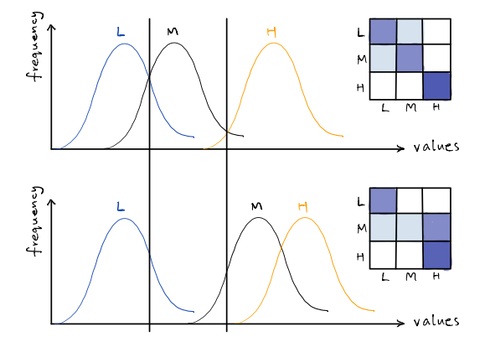
Error Analysis
Possible sources of error
Noise in the dataset
Randomness caused by individual differences
Data distribution
(a)
(b)
Confusion in results of a tri-classification task: A -> B

Slide 42
Error Analysis
Discussion on real-time classification
We divide 3×10min EEG sequence into 2s short sequences so that the trained model would be usable under real-time restraints
From A -> A test: Both CNN model and feature-based ML models are able to reach satisfying accuracy in single-session classification. Compared to existing studies, our model has higher classification accuracy and fair robustness, which should make it suitable for H/M/L attentional level monitoring in real world applications.

Slide 43
Error Analysis
In real-world applications, consider：
Using historical data from single subject as training set, and the fitted model to monitor attentional level of the same subject, or
Using large-scale, varied EEG data set as training set, and the fitted model to monitor attentional level of new subjects

Slide 44
Advantages and Disadvantages
Advantages
Design of the solution has exploited the characteristics of our dataset, the goal and background of the scientific problem
Real-time: short EEG sequences
Exploit the dataset: A -> A, A -> B, others -> A
Comparison of different models
Interdisciplinary: experimental design focuses on the combination of mental status and electrophysiological signals
Disadvantages
Small dataset, Singular evaluation metrics, etc.

Slide 45
Discussion
What about bi-classification?
In tri-classification, we repeatedly see values near 0，33%，67%

Slide 46
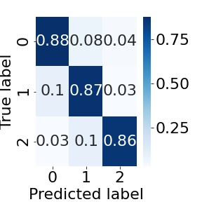
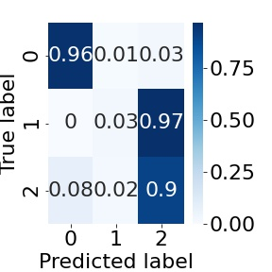
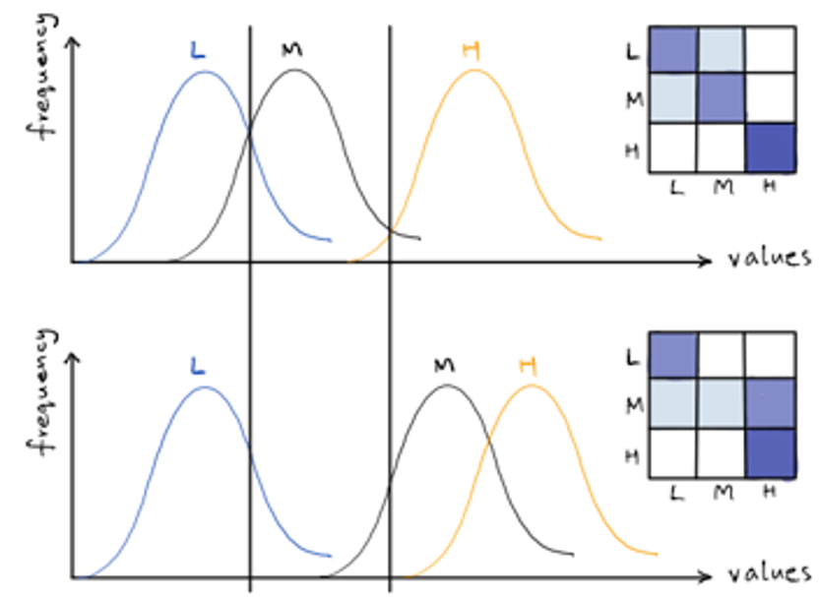
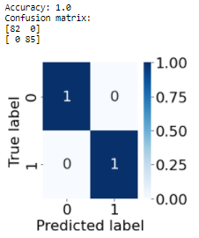
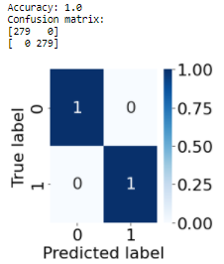
深入思考的问题
What about bi-classification?
Sample: subject (0006, 0013)
(a)
(b)

Slide 47
Discussion
Fast pre-pocessing of EEG data
Koji et al. uses ±80μV as a threshold for EEG data cropping. Eoh et al. uses 50-70μV. Both reached satisfying results.
Our study: filtration+60μV rejection threshold
To apply more strict quality control on the consistency of our data, different rejection threshold should be adopted for different sessions, and standardizing transformation should be made on EEG sequences.
Suitable solutions design for fast EEG pre-processing should consider:
Metrics of EEG data distribution, such as expectation, variance, higher-order moments, convolutional features, nonlinear features, local features, etc.
Design of special mathematical transform that guarantees same distribution for all transformed data
Evaluation and validation of the transform method

Slide 48
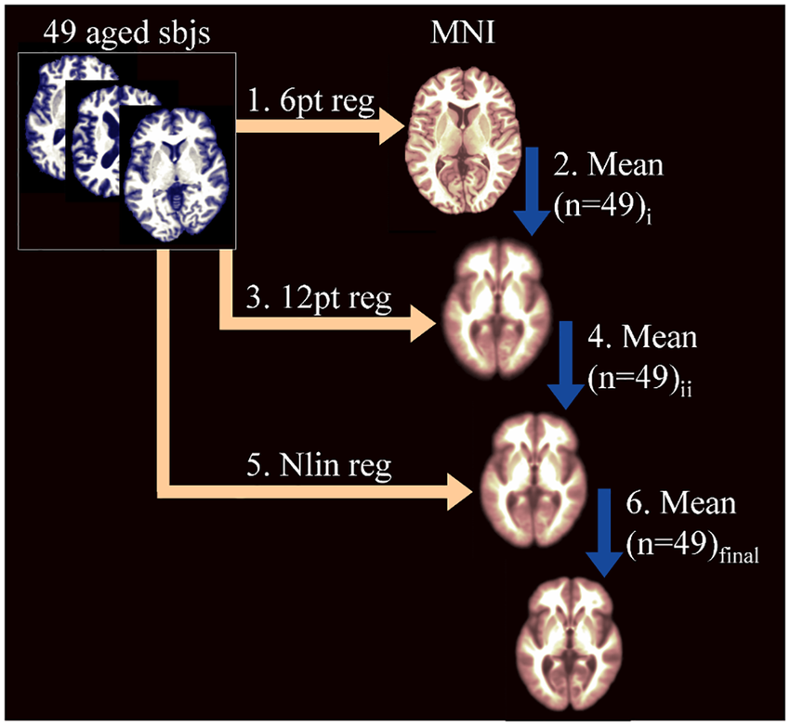
Discussion
Standardizing EEG data: ideas inspired by MRI registration
The preprocessing of EEG can remove noise and artifacts in EEG data and greatly improve data quality. However, for data sets with a high degree of sample diversity, data standardization is also the key to data analysis, classification and data mining
Taking MRI image processing as an example, the standardization of data processing and quality control procedures include orientation adjustment, registration and other necessary preprocessing, and then the brain image data of different subjects are mapped to a standard space, such as the MNI template (Montreal Neurological Institute Template) )
But for EEG data, there is still a lack of a unified preprocessing process

Slide 49
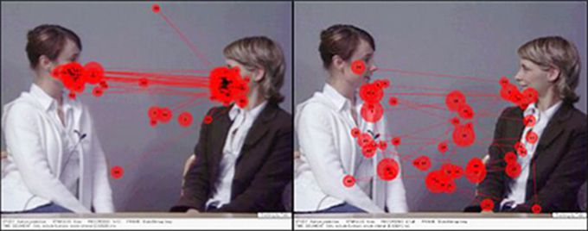
Discussion
Potential application in integrated attentional level detection
Some methods for attentional level detection may be used under limited conditions, thus can be applied as supplements to EEG detection.
E.g. Monitor the driver’s attentional level based on eye-movements
Implementation of attentional level detection on mobile devices
Improve the reliability using multi-channel detection methods

Slide 50
References
[1] 谢东.关于航空疲劳飞行的研究综述[J].科技传播,2014,(9):67-67,79.
[2] Gianluca, Borghini, Laura, et al. Measuring neurophysiological signals in aircraft pilots and car drivers for the assessment of mental workload, fatigue and drowsiness. Neuroscience & Biobehavioral Reviews, 2014.
[3] 杨焕,燕西康,李东方, 等.飞行疲劳的研究进展[J].中国现代医生,2012,50(29):27-28.
[4] Lee D H , Jeong J H , Kim K , et al. Continuous EEG Decoding of Pilots' Mental States using Multiple Feature Block-based Convolutional Neural Network. IEEE Access, 2020, PP(99):1-1.
[5] 庄达民, 完颜笑如. 飞行员注意力分配理论与应用[M]. 科学出版社, 2013.
[6] Smith M E , Gevins A . Neurophysiologic monitoring of mental workload and fatigue during operation of a flight simulator. Proceedings of SPIE - The International Society for Optical Engineering, 2005, 5797:116-126.
[7] CAO Z, CHUANG C-H, KING J-K, et al. Multi-channel EEG recordings during a sustained-attention driving task. Scientific data, 2019, 6(1):19.
[8] WEI C-S, WANG Y-T, LIN C-T, et al. Toward Drowsiness Detection Using Non-hair-Bearing EEG-Based Brain-Computer Interfaces. IEEE transactions on neural systems and rehabilitation engineering : a publication of the IEEE Engineering in Medicine and Biology Society, 2018, 26(2):400–406.
[9] Lin B S , Hsu H C , Jan G E , et al. An Interactive Upper-Limb Post-Stroke Rehabilitation System Integrating BCI-based Attention Monitoring and Virtual Reality Feedback// Third International Conference on Computing Measurement Control & Sensor Network. IEEE, 2017.
[10] Picton, Terence W . The P300 Wave of the Human Event-Related Potential. Journal of Clinical Neurophysiology, 1992, 9(4):456-479.
[11] Koji K . A brain-computer interface for potential non-verbal facial communication based on EEG signals related to specific emotions. Frontiers in Neuroscience, 2014, 8(8):244.
[12] Schier M A . Changes in EEG alpha power during simulated driving: a demonstration. International Journal of Psychophysiology Official Journal of the International Organization of Psychophysiology, 2000, 37(2):155-162.
[13] Eoh H J , Chung M K , Kim S H . Electroencephalographic study of drowsiness in simulated driving with sleep deprivation. International Journal of Industrial Ergonomics, 2005, 35(4):307-320.
[14] WANG H, DRAGOMIR A, ABBASI N I, et al. A novel real-time driving fatigue detection system based on wireless dry EEG. Cognitive neurodynamics, 2018, 12(4):365–376.
[15] 王海玉, 王映龙, 闵建亮,等. 基于小波变换与多项指标的疲劳驾驶检测应用[J]. 计算机与现代化, 2018, 000(010):32-35,43.
[16] Subasi A . Automatic recognition of alertness level from EEG by using neural network and wavelet coefficients. Expert Systems with Applications, 2005, 28( 4):701-711.
[17] Pincus S M. Approximate entropy as a measure of system complexity.Proceedings of the National Academy of Science,1991,88(6):2297-2301

Slide 51
References
[18] Richman, Joshua, S, et al. Physiological time-series analysis using approximate entropy and sample entropy. American Journal of Physiology, 2000.
[19] Xu L , Liu J , Xiao G , et al. Characterization and Classification of EEG Attention Based on Fuzzy Entropy// International Conference on Digital Manufacturing & Automation. IEEE Computer Society, 2012.
[20] Kannathal N , Choo M L , Acharya U R , et al. Entropies for detection of epilepsy in EEG. Computer Methods and Programs in Biomedicine, 2005, 80(3):187-194.
[21] 吴欢,印想,官金安.频带能量与样本熵在注意力脑电信号中的对比研究[J].计算机与数字工程,2020,48(3):603-606,622.
[22] Hu J , Min J . Automated detection of driver fatigue based on EEG signals using gradient boosting decision tree model. Cognitive Neurodynamics, 2018.
[23] Kashihara, Koji. Automatic discrimination of attention levels estimated by frontal EEG activity in drivers. 2017:194-197.
[24] Almogbel M A , Dang A H , Kameyama W . EEG-signals based cognitive workload detection of vehicle driver using deep learning// 2018 20th International Conference on Advanced Communications Technology (ICACT). 2018.
[25] A. Costa-García, E. Iáez, Del-Ama A J , et al. EEG model stability and online decoding of attentional demand during gait using gamma band features. Neurocomputing, 2019, 360:151-162.
[26] Marturano, Francesca & Brigadoi, Sabrina & Doro, Mattia & Dell'Acqua, Roberto & Sparacino, Giovanni. (2019). Development and Test of an ERP Simulator Emulating Visual N2 Variability in Amplitude and Latency.
[27] Evelyn Gianfranchi,Giovanni Mento,Gian Marco Duma,Christian Chierchia,Michela Sarlo,Mariaelena Tagliabue. Electrophysiological correlates of attentional monitoring during a complex driving simulation task. Biological Psychology,2020,154.
[28] Gianfranchi E , Mento G , Duma G M , et al. Electrophysiological correlates of attentional monitoring during a complex driving simulation task. Biological Psychology, 2020, 154:107918.
[29] L. Cohen, "Time–Frequency Analysis," Prentice-Hall, New York, 1995. ISBN 978-0135945322
[28] C. T. Lin, S. A. Chen, T. T. Chiu, H. Z. Lin, and L. W. Ko, “Spatial and temporal EEG dynamics of dual-task driving performance,” Journal of neuroengineering and rehabilitation, vol. 8, no. 1, pp. 1-13, 2011.
[29] T. W. Picton, “The P300 wave of the human event-related potential,” Journal of clinical neurophysiology, vol. 9, no. 4, pp. 456-479, 1992.
[13] Eoh H J , Chung M K , Kim S H . Electroencephalographic study of drowsiness in simulated driving with sleep deprivation[J]. International Journal of Industrial Ergonomics, 2005, 35(4):307-320.
[32]Quinlan J R, Introduction of decision trees[J]. Machine learning, 1986, I(1)81-106
[30] Gibson Z , Butterfield J , Rodger M , et al. Use of Dry Electrode Electroencephalography (EEG) to Monitor Pilot Workload and Distraction Based on P300 Responses to an Auditory Oddball Task[M]// Advances in Neuroergonomics and Cognitive Engineering. 2019.

Slide 52
References
[31] C. T. Lin, S. A. Chen, T. T. Chiu, H. Z. Lin, and L. W. Ko, “Spatial and temporal EEG dynamics of dual-task driving performance,” Journal of neuroengineering and rehabilitation, vol. 8, no. 1, pp. 1-13, 2011.
[32] T. W. Picton, “The P300 wave of the human event-related potential,” Journal of clinical neurophysiology, vol. 9, no. 4, pp. 456-479, 1992.
[33] K. Kashihara, “A brain-computer interface for potential nonverbal facial communication based on EEG signals related to specific emotions,” Frontiers in Neuroscience, vol. 8, no. 244, pp. 1-12, 2014.
[34] Sakhnovich A . Nonisospectral integrable nonlinear equations with external potentials and their GBDT solutions[J]. Journal of Physics A Mathematical & Theoretical, 2007, 41(15).
[36] Ocak H . Automatic detection of epileptic seizures in EEG using discrete wavelet transform and approximate entropy[J]. Expert Systems with Applications, 2009.
[37]Delorme, A., & Makeig, S. (2004). EEGLAB: an open source toolbox for analysis of single-trial EEG dynamics including independent component analysis. Journal of neuroscience methods, 134(1), 9-21.
[38] Xu L , Liu J , Xiao G , et al. Characterization and Classification of EEG Attention Based on Fuzzy Entropy[C]// International Conference on Digital Manufacturing & Automation. IEEE Computer Society, 2012.

